Slide 1
STUDY ABROAD לימודים בחו"ל

Slide 2
ERASMUS+
What is Erasmus+?
Erasmus+ is the EU's programme to support education, training, youth and sport in Europe. Its budget of €14.7 billion will provide opportunities for over 4 million Europeans to study, train, gain experience, and volunteer abroad.
Set to last until 2020, Erasmus+ doesn't just have opportunities for students. Merging seven prior programmes, it has opportunities for a wide variety of individuals and organisations.
Aims:
The aim of Erasmus+ is to contribute to the Europe 2020 strategy for growth, jobs, social equity and inclusion, as well as the aims of ET2020, the EU's strategic framework for education and training.
http://ec.europa.eu/programmes/erasmus-plus/opportunities_en

Slide 3
Grant: 800 EUR per month (30 days) 360 Euro - Travel

Slide 4
With whom do we have relations?
Institutions which have agreements with ACW

Slide 5
1.
TRANSITION HEADLINE
Lithuanian Sport University

Slide 6
5 students:
2 – Second Semester (5 mns)
3 – Second Semester/Internships (min 2 mns)
Courses:
B.A. – Sports Management, Physiotherapy, Coaching, PA and Lifestyle
M.A. – PA and Public Health, Tourism and Sports Management, Physiotherapy

Slide 7
2.
TRANSITION HEADLINE
Palacky University, Olomouc,
Czech Republic

Slide 8
2 students – Second Semester/Internship
Courses offered 2018/2019

Slide 9
3.
TRANSITION HEADLINE
Latvian Academy of Sport Education,
Riga, Latvia

Slide 10
4 students – Second Semester
Courses:
Movement physiology, Health Care Management, Tech in Rehab Assessment, Manual Therapy in Sport, Sport Psychology, Health Psychology, Physiotherapy, Sport Traumatology
Dates: Feb-April; April-June; March-June;
Internships (min 2 mns)

Slide 11
4.
TRANSITION HEADLINE
University of Physical Education, Budapest, Hungary

Slide 12
5.
TRANSITION HEADLINE
University of Split,
Split, Croatia

Slide 13
Tsukuba Summer Institute 2018
siit.jp/

Slide 14
Week-long international seminar/workshop for undergraduate & graduate students in physical education & sport sciences
Collaborative Research Planning
Laboratory
Sports, Physical Activity, & Culture in Japan
International Development through Sport

Slide 15
July 9-16, 2019
Scholarships – 2 students
Students can attend at own cost:
The TSI participation fee is likely to be ¥20,000 JPY (~ 660 NIS) per student (orientation reception, daily lunches, mid-week outdoor BBQ, and all program activities are covered by the participation fee) ▪ Accommodation is arranged by the local organizing committee (primarily residencestyle) and is considerably more affordable than hotels (generally between ~ ¥2,500 JPY (~85 NIS) and ¥4,500 JPY per night)

Slide 16
Interested?
Apply
Fill in form with details and send to debbieh.erasmus@gmail.com
Interview
Meet with Shayke and Debbie
Formal Application to Institution
Send application forms, housing, insurance, health statement

Slide 18
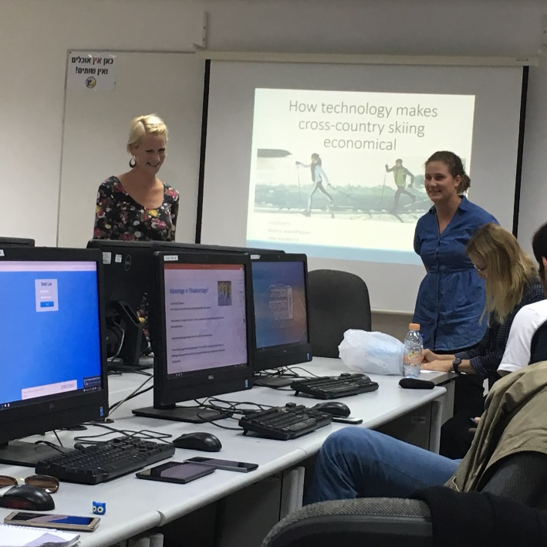
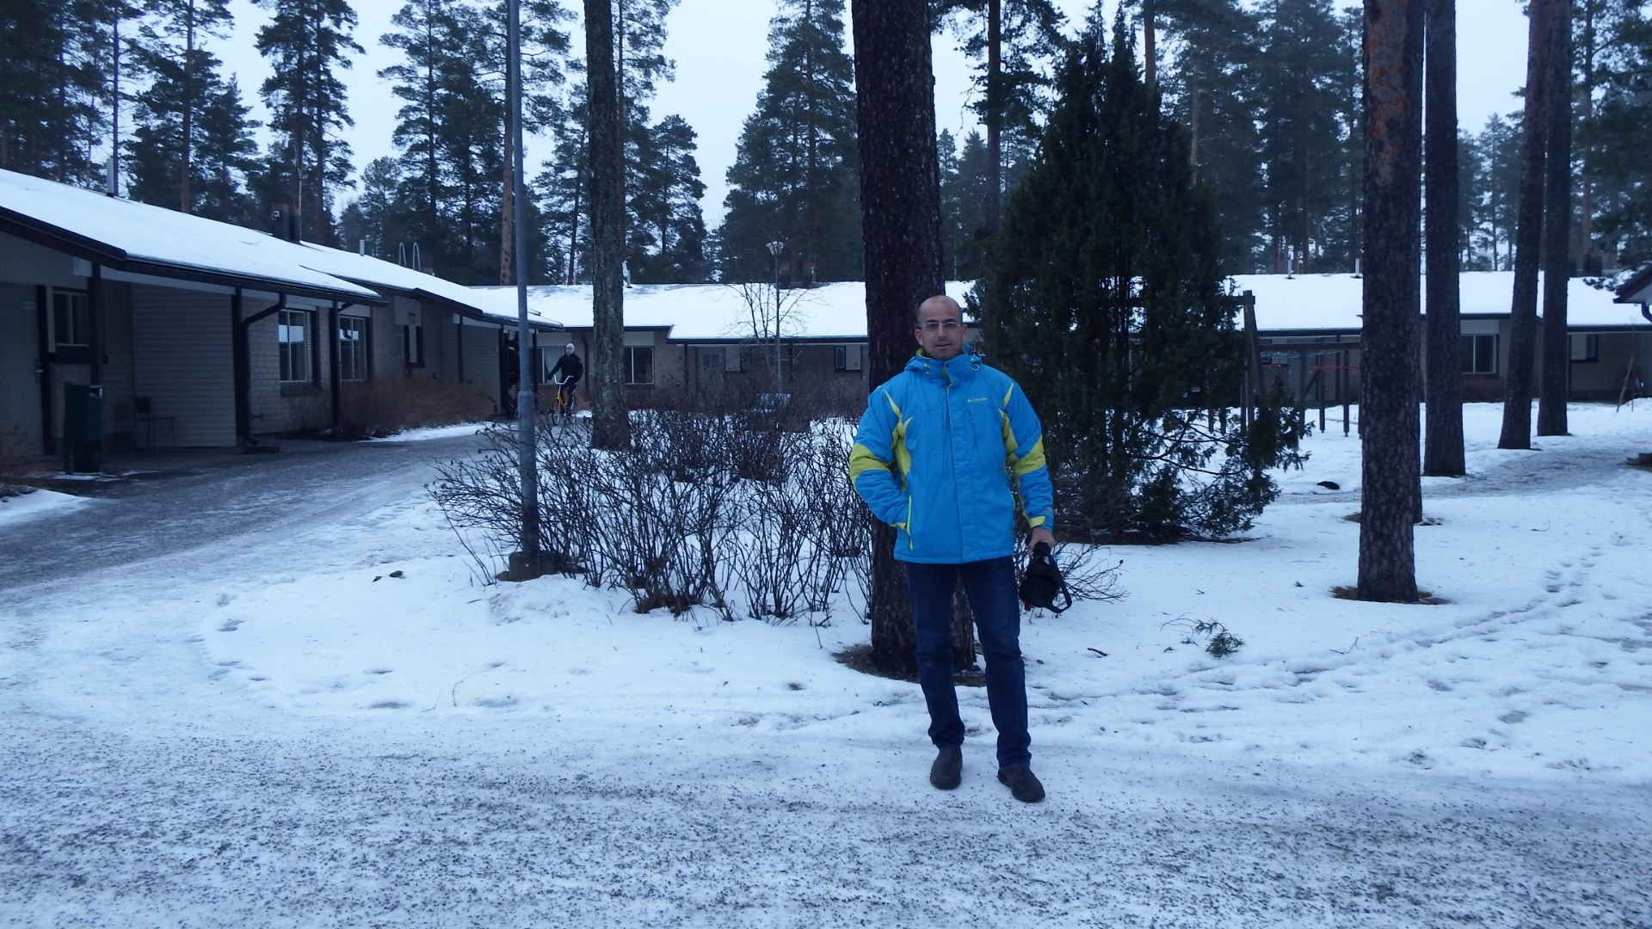
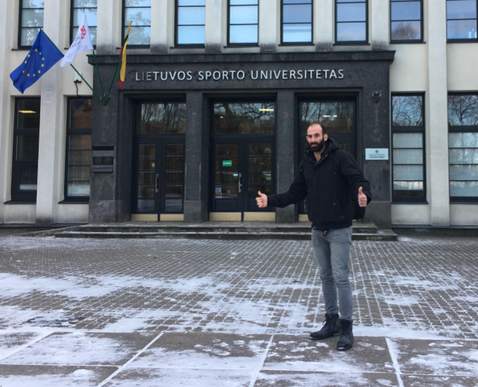
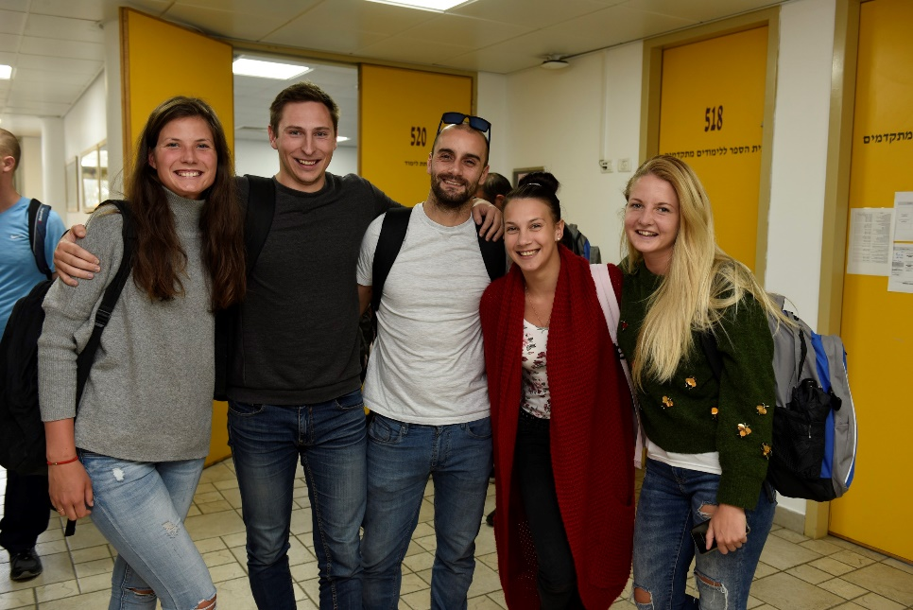
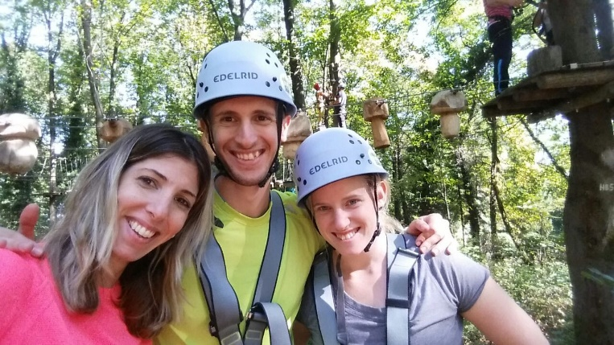
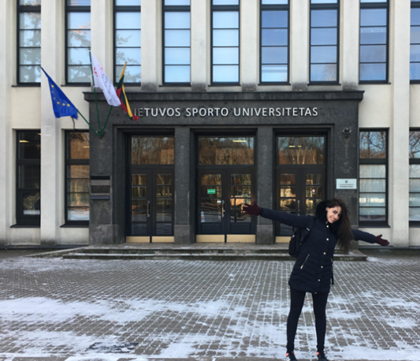
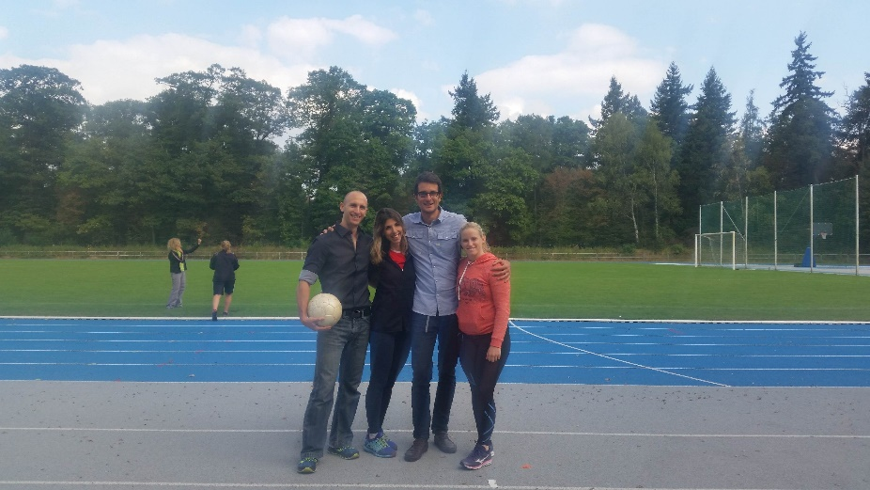
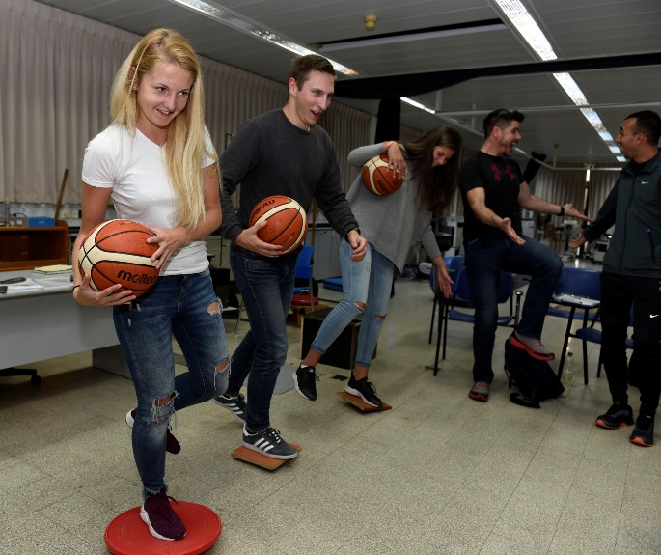

Slide 19
THANKS!
Any questions?
Debbieh.erasmus@gmail.com
0523-628-528

